Slide 1
CHAPTER 10
ESTIMATION AND HYPOTHESIS TESTING: TWO POPULATIONS
Prem Mann, Introductory Statistics, 8/E Copyright © 2013 John Wiley & Sons. All rights reserved.

Slide 2
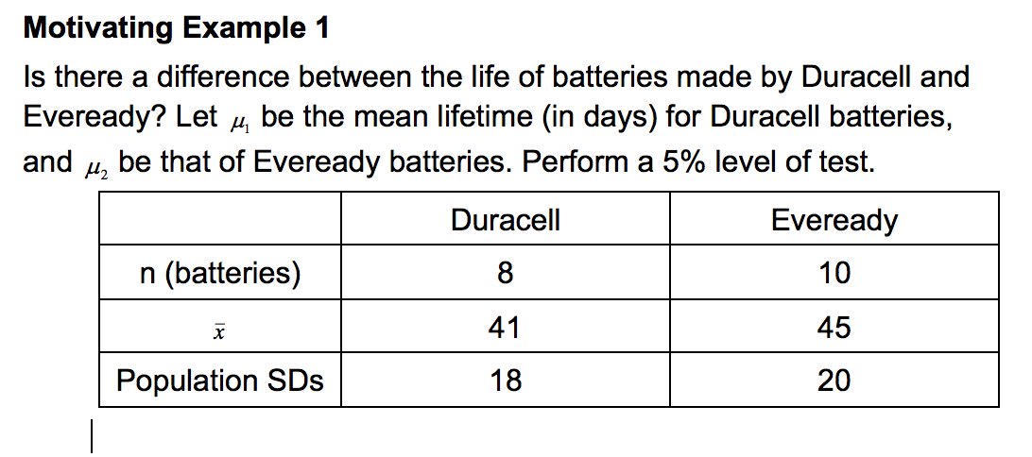
Testing Hypothesis about Means: Two Sample

Slide 3
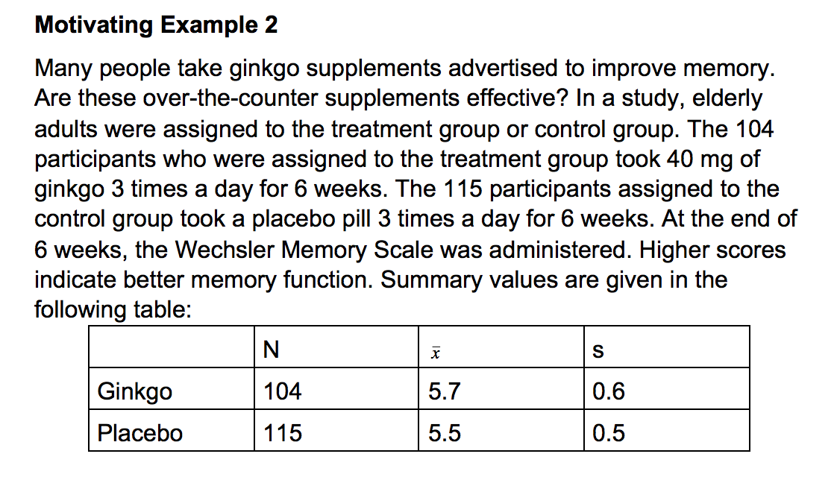
Testing Hypothesis about Means: Two Sample

Slide 4
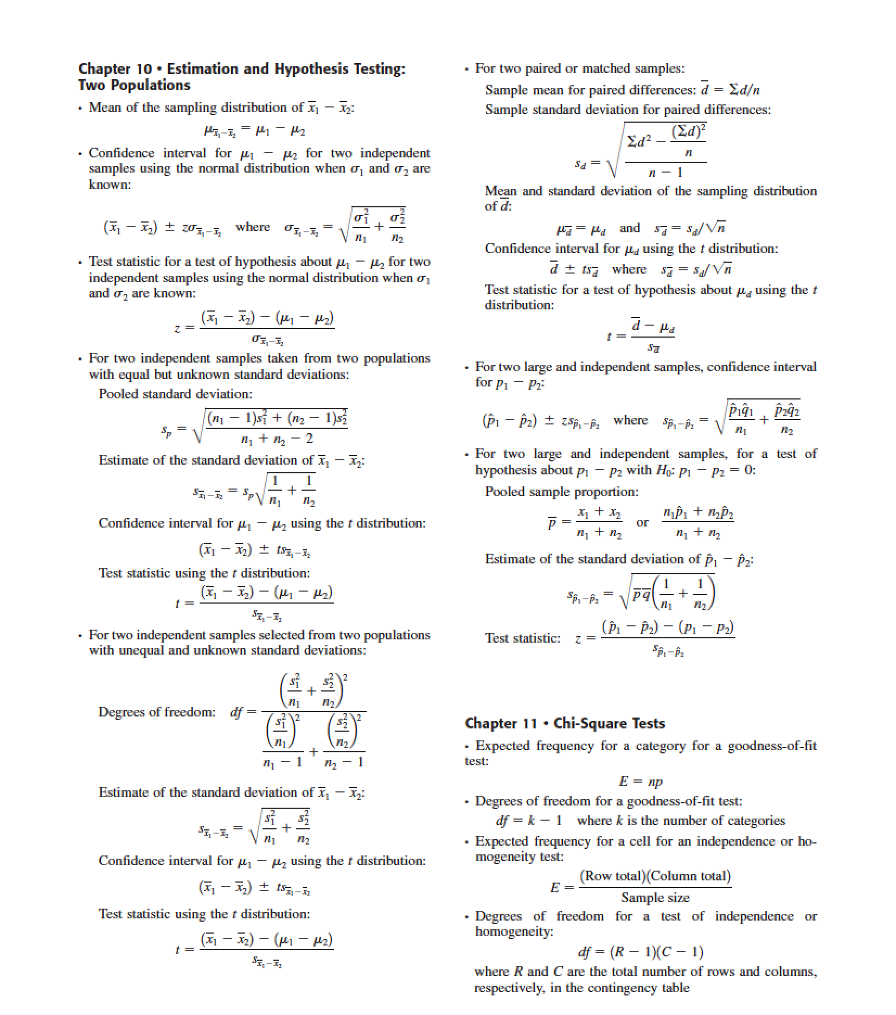

Slide 5

INFERENCES ABOUT THE DIFFERENCE BETWEEN TWO POPULATION MEANS FOR INDEPENDENT SAMPLES: σ₁ AND σ₂ KNOWN
Independent versus Dependent Samples
Mean, Standard Deviation, and Sampling Distribution of x₁ – x₂
Interval Estimation of μ₁ – μ₂
Hypothesis Testing About μ₁ – μ₂
Prem Mann, Introductory Statistics, 8/E Copyright © 2013 John Wiley & Sons. All rights reserved.

Slide 6
Independent versus Dependent Samples
Definition
Two samples drawn from two populations are independent if the selection of one sample from one population does not affect the selection of the second sample from the second population. Otherwise, the samples are dependent.
Prem Mann, Introductory Statistics, 8/E Copyright © 2013 John Wiley & Sons. All rights reserved.

Slide 7
Example 10-1
Suppose we want to estimate the difference between the mean salaries of all male and all female executives. To do so, we draw two samples, one from the population of male executives and another from the population of female executives. These two samples are independent because they are drawn from two different populations, and the samples have no effect on each other.
Prem Mann, Introductory Statistics, 8/E Copyright © 2013 John Wiley & Sons. All rights reserved.

Slide 8
Example 10-2
Suppose we want to estimate the difference between the mean weights of all participants before and after a weight loss program. To accomplish this, suppose we take a sample of 40 participants and measure their weights before and after the completion of this program. Note that these two samples include the same 40 participants. This is an example of two dependent samples. Such samples are also called paired or matched samples.
Prem Mann, Introductory Statistics, 8/E Copyright © 2013 John Wiley & Sons. All rights reserved.

Slide 9
Mean, Standard Deviation, and Sampling Distribution of x₁ – x₂
Three conditions:
The two samples are independent
The standard deviations σ₁ and σ₂ of the two populations are known
At least one of the following conditions is fulfilled:
i. Both samples are large (i..e., n₁ ≥ 30 and n₂ ≥ 30)
ii. If either one or both sample sizes are small, then both populations from which the samples are drawn are normally distributed
Then the sampling distribution of x₁ - x₂ is (approximately) normally distributed.
Prem Mann, Introductory Statistics, 8/E Copyright © 2013 John Wiley & Sons. All rights reserved.

Slide 10
Sampling Distribution, Mean, and Standard Deviation of x₁ – x₂
When the conditions listed on the previous page are satisfied, the sampling distribution of is (approximately) normal with its mean and standard deviation as follows:
and
Prem Mann, Introductory Statistics, 8/E Copyright © 2013 John Wiley & Sons. All rights reserved.

Slide 11
Confidence Interval for μ₁ – μ₂
When using the normal distribution, the (1–α)100%
confidence interval for μ₁ – μ₂ is
The value of z is obtained from the normal distribution table
for the given confidence level. The value of is
calculated as explained earlier. Here is the point
estimator of μ₁ – μ₂
Prem Mann, Introductory Statistics, 8/E Copyright © 2013 John Wiley & Sons. All rights reserved.

Slide 12
Example 10-3
According to Kaiser Family Foundation survey in 2011 and 2010, the average premium for employer-sponsored health insurance for family coverage was $15,073 in 2011 and $13,770 in 2010 (USA TODAY, September 29, 2011). Suppose that these averages were based on random samples of 250 and 200 employees who had such employer-sponsored health insurance plans for 2011 and 2010, respectively. Further assume that the population standard deviations for 2011 and 2010 were $2160 and $1990, respectively.
Prem Mann, Introductory Statistics, 8/E Copyright © 2013 John Wiley & Sons. All rights reserved.

Slide 13
Example 10-3
Let μ₁ and μ₂ be the respective population means for such annual premiums for the years 2011 and 2010, respectively.
(a) What is the point estimate of μ₁ – μ₂?
(b) Construct a 97% confidence interval for μ₁ – μ₂.
Prem Mann, Introductory Statistics, 8/E Copyright © 2013 John Wiley & Sons. All rights reserved.

Slide 14
Example 10-3: Solution
(a) Point estimate of μ₁ – μ₂ = the value of
= $15,073 - $13,770 = $1303
Prem Mann, Introductory Statistics, 8/E Copyright © 2013 John Wiley & Sons. All rights reserved.

Slide 15
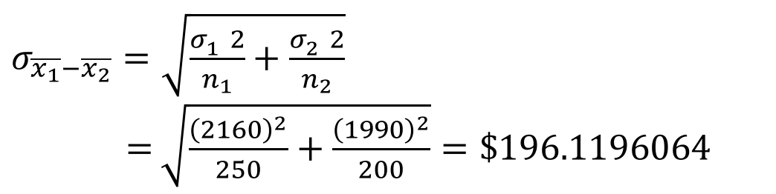
Example 10-3: Solution
(b)
$σ_{\overline{x_{1}}−\overline{x_{2}}}=\sqrt{\frac{σ_{1}^{}2}{n_{1}}+\frac{σ_{2}^{}2}{n_{2}}}$
$=$ $\sqrt{\frac{{\left(2160\right)}^{2}}{250}+\frac{{\left(1990\right)}^{2}}{200}}=\$196.1196064$
Prem Mann, Introductory Statistics, 8/E Copyright © 2013 John Wiley & Sons. All rights reserved.

Slide 16
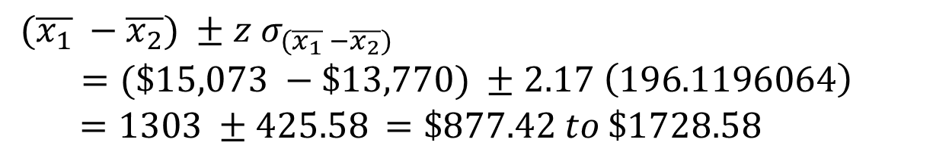
Example 10-3: Solution
(b) 97% confidence level. The value of z is 2.17
Thus, with 97% confidence we can state that the difference between the average annual premiums for employer-sponsored health insurance for family coverage in 2011 and 2010 is between $877.42 to $1728.58.
${ (\overline{x_{1}} −\overline{x_{2}}) ±z σ}_{(\overline{x_{1}} −\overline{x_{2}})}$
$$=(\$15,073 −\$13,770) ±2.17 \left(196.1196064\right)$$
$=1303 ±425.58$ $=\$877.42 to \$1728.58$
Prem Mann, Introductory Statistics, 8/E Copyright © 2013 John Wiley & Sons. All rights reserved.

Slide 17
Hypothesis Testing About μ₁ – μ₂
Testing an alternative hypothesis that the means of two populations are different is equivalent to μ₁ ≠ μ₂, which is the same as μ₁ - μ₂ ≠ 0.
Prem Mann, Introductory Statistics, 8/E Copyright © 2013 John Wiley & Sons. All rights reserved.

Slide 18
HYPOTHESIS TESTING ABOUT μ₁ – μ₂
Testing an alternative hypothesis that the mean of the first population is greater than the mean of the second population is equivalent to μ₁ > μ₂, which is the same as μ₁ - μ₂ > 0.
Prem Mann, Introductory Statistics, 8/E Copyright © 2013 John Wiley & Sons. All rights reserved.

Slide 19
HYPOTHESIS TESTING ABOUT μ₁ – μ₂
Testing an alternative hypothesis that the mean of the first population is less than the mean of the second population is equivalent to μ₁ < μ₂, which is the same as μ₁ - μ₂ < 0.
Prem Mann, Introductory Statistics, 8/E Copyright © 2013 John Wiley & Sons. All rights reserved.

Slide 20
HYPOTHESIS TESTING ABOUT μ₁ – μ₂
Test Statistic z for x₁ – x₂
When using the normal distribution, the value of the test
statistic z for is computed as
The value of μ₁ – μ₂ is substituted from H₀. The value of
is calculated as earlier in this section.
Prem Mann, Introductory Statistics, 8/E Copyright © 2013 John Wiley & Sons. All rights reserved.

Slide 21
Example 10-4
Refer to Example 10-3 about the average annual premiums for employer-sponsored health insurance for family coverage in 2011 and 2010. Test at the 1% significance level whether the population means for the two years are different.
Prem Mann, Introductory Statistics, 8/E Copyright © 2013 John Wiley & Sons. All rights reserved.

Slide 22
Example 10-4: Solution
Step 1:
H₀: μ₁ – μ₂ = 0 (The two population means are not different.)
H₁: μ₁ – μ₂ ≠ 0 (The two population means are different.)
Prem Mann, Introductory Statistics, 8/E Copyright © 2013 John Wiley & Sons. All rights reserved.

Slide 23
Example 10-4: Solution
Step 2:
Population standard deviations, σ₁ and σ₂, are known
Both samples are large; n₁ > 30 and n₂ > 30
Therefore, we use the normal distribution to perform the
hypothesis test.
Prem Mann, Introductory Statistics, 8/E Copyright © 2013 John Wiley & Sons. All rights reserved.

Slide 24
Example 10-4: Solution
Step 3:
α = .01.
The ≠ sign in the alternative hypothesis indicates that the
test is two-tailed
Area in each tail = α / 2 = .01 / 2 = .005
The critical values of z are 2.58 and -2.58
Prem Mann, Introductory Statistics, 8/E Copyright © 2013 John Wiley & Sons. All rights reserved.

Slide 25
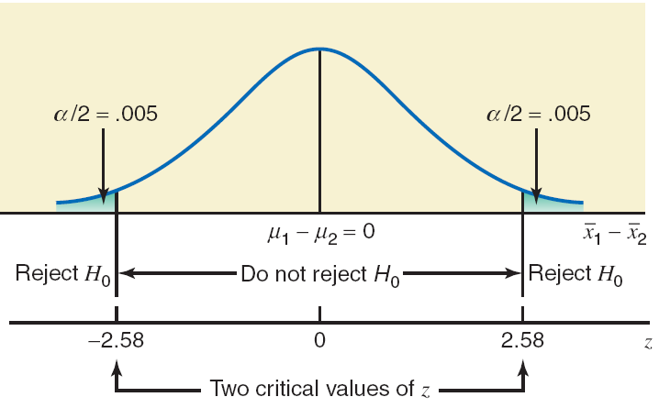
Figure 10.2
Prem Mann, Introductory Statistics, 8/E Copyright © 2013 John Wiley & Sons. All rights reserved.

Slide 26
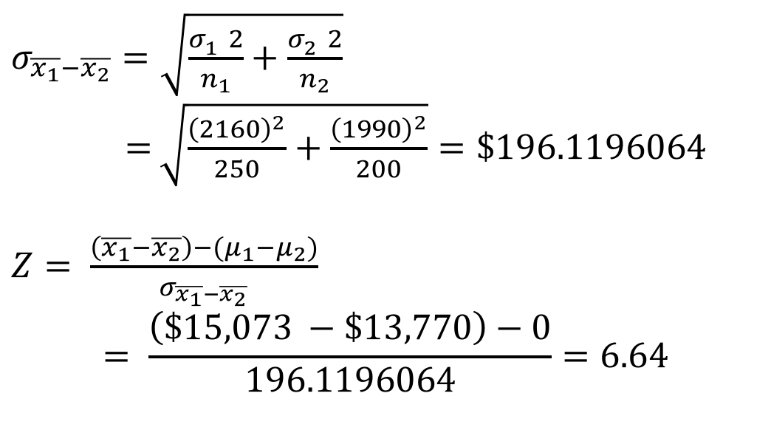
Example 10-4: Solution
Step 4:
$σ_{\overline{x_{1}}−\overline{x_{2}}}=\sqrt{\frac{σ_{1}^{}2}{n_{1}}+\frac{σ_{2}^{}2}{n_{2}}}$
$=$ $\sqrt{\frac{{\left(2160\right)}^{2}}{250}+\frac{{\left(1990\right)}^{2}}{200}}=\$196.1196064$
$Z= \frac{\left(\overline{x_{1}}−\overline{x_{2}}\right)−(μ_{1}−μ_{2})}{σ_{\overline{x_{1}}−\overline{x_{2}}}}$
$$= \frac{\left(\$15,073 −\$13,770\right)−0}{196.1196064}=6.64$$
From H₀
Prem Mann, Introductory Statistics, 8/E Copyright © 2013 John Wiley & Sons. All rights reserved.

Slide 27
Example 10-4: Solution
Step 5:
Because the value of the test statistic z = 6.64 falls in the
rejection region, we reject the null hypothesis H₀.
Therefore, we conclude that the average annual premiums
for employer-sponsored health insurance for family
coverage were different for 2011 and 2010.
Prem Mann, Introductory Statistics, 8/E Copyright © 2013 John Wiley & Sons. All rights reserved.

Slide 28

INFERENCES ABOUT THE DIFFERENCE BETWEEN TWO POPULATION MEANS FOR INDEPENDENT SAMPLES: σ₁ AND σ₂ UNKNOWN BUT EQUAL
Interval Estimation of μ₁ – μ₂
Hypothesis Testing About μ₁ – μ₂
Prem Mann, Introductory Statistics, 8/E Copyright © 2013 John Wiley & Sons. All rights reserved.

Slide 29
Pooled Standard Deviation for Two Samples
The pooled standard deviation for two samples is computed as
where n₁ and n₂ are the sizes of the two samples and and are the variances of the two samples, respectively. Here is an estimator of σ.
Prem Mann, Introductory Statistics, 8/E Copyright © 2013 John Wiley & Sons. All rights reserved.

Slide 30
Estimator of the Standard Deviation of x₁ – x₂
Estimator of the Standard Deviation of x₁ – x₂
The estimator of the standard deviation of is
Prem Mann, Introductory Statistics, 8/E Copyright © 2013 John Wiley & Sons. All rights reserved.

Slide 31
Interval Estimation of μ₁ – μ₂
Confidence Interval for μ₁ – μ₂
The (1 – α)100% confidence interval for μ₁ – μ₂ is
where the value of t is obtained from the t distribution table
for the given confidence level and n₁ + n₂ – 2 degrees of
freedom, and is calculated as explained earlier.
Prem Mann, Introductory Statistics, 8/E Copyright © 2013 John Wiley & Sons. All rights reserved.

Slide 32
Example 10-5
A consumer agency wanted to estimate the difference in the mean amounts of caffeine in two brands of coffee. The agency took a sample of 15 one-pound jars of Brand I coffee that showed the mean amount of caffeine in these jars to be 80 milligrams per jar with a standard deviation of 5 milligrams. Another sample of 12 one-pound jars of Brand II coffee gave a mean amount of caffeine equal to 77 milligrams per jar with a standard deviation of 6 milligrams.
Prem Mann, Introductory Statistics, 8/E Copyright © 2013 John Wiley & Sons. All rights reserved.

Slide 33
Example 10-5
Construct a 95% confidence interval for the difference between the mean amounts of caffeine in one-pound jars of these two brands of coffee. Assume that the two populations are normally distributed and that the standard deviations of the two populations are equal.
Prem Mann, Introductory Statistics, 8/E Copyright © 2013 John Wiley & Sons. All rights reserved.

Slide 34
Example 10-5: Solution
Prem Mann, Introductory Statistics, 8/E Copyright © 2013 John Wiley & Sons. All rights reserved.

Slide 35
Example 10-5: Solution
Prem Mann, Introductory Statistics, 8/E Copyright © 2013 John Wiley & Sons. All rights reserved.

Slide 36
Hypothesis Testing About μ₁ – μ₂
Test Statistic t for x₁ – x₂
The value of the test statistic t for x₁ – x₂ is computed as
The value of μ₁ – μ₂ in this formula is substituted from the null
hypothesis and is calculated as explained earlier.
Prem Mann, Introductory Statistics, 8/E Copyright © 2013 John Wiley & Sons. All rights reserved.

Slide 37
Example 10-6
A sample of 14 cans of Brand I diet soda gave the mean number of calories of 23 per can with a standard deviation of 3 calories. Another sample of 16 cans of Brand II diet soda gave the mean number of calories of 25 per can with a standard deviation of 4 calories.
Prem Mann, Introductory Statistics, 8/E Copyright © 2013 John Wiley & Sons. All rights reserved.

Slide 38
Example 10-6
At the 1% significance level, can you conclude that the mean number of calories per can are different for these two brands of diet soda? Assume that the calories per can of diet soda are normally distributed for each of the two brands and that the standard deviations for the two populations are equal.
Prem Mann, Introductory Statistics, 8/E Copyright © 2013 John Wiley & Sons. All rights reserved.

Slide 39
Example 10-6: Solution
Step 1:
H₀: μ₁ – μ₂ = 0
(The mean numbers of calories are not different.)
H₁: μ₁ – μ₂ ≠ 0
(The mean numbers of calories are different.)
Prem Mann, Introductory Statistics, 8/E Copyright © 2013 John Wiley & Sons. All rights reserved.

Slide 40
Example 10-6: Solution
Step 2:
The two samples are independent
σ₁ and σ₂ are unknown but equal
The sample sizes are small but both populations are
normally distributed
We will use the t distribution
Prem Mann, Introductory Statistics, 8/E Copyright © 2013 John Wiley & Sons. All rights reserved.

Slide 41
Example 10-6: Solution
Step 3:
The ≠ sign in the alternative hypothesis indicates that the
test is two-tailed.
α = .01.
Area in each tail = α / 2 = .01 / 2 = .005
df = n₁ + n₂ – 2 = 14 + 16 – 2 = 28
Critical values of t are -2.763 and 2.763.
Prem Mann, Introductory Statistics, 8/E Copyright © 2013 John Wiley & Sons. All rights reserved.

Slide 42
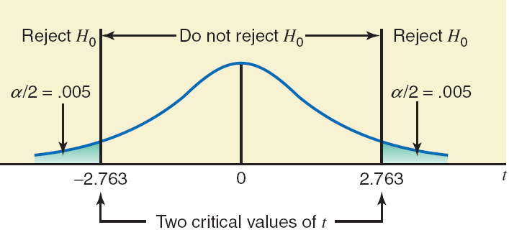
Figure 10.3
Prem Mann, Introductory Statistics, 8/E Copyright © 2013 John Wiley & Sons. All rights reserved.

Slide 43
Example 10-6: Solution
Step 4:
Prem Mann, Introductory Statistics, 8/E Copyright © 2013 John Wiley & Sons. All rights reserved.

Slide 44
Example 10-6: Solution
Step 5:
The value of the test statistic t = -1.531
  It falls in the nonrejection region
Therefore, we fail to reject the null hypothesis
Consequently, we conclude that there is no difference in
the mean numbers of calories per can for the two brands of
diet soda.
Prem Mann, Introductory Statistics, 8/E Copyright © 2013 John Wiley & Sons. All rights reserved.

Slide 45

INFERENCES ABOUT THE DIFFERENCE BETWEEN TWO POPULATION MEANS FOR INDEPENDENT SAMPLES: σ₁ AND σ₂ UNKNOWN AND UNEQUAL
Interval Estimation of μ₁ – μ₂
Hypothesis Testing About μ₁ – μ₂
Prem Mann, Introductory Statistics, 8/E Copyright © 2013 John Wiley & Sons. All rights reserved.

Slide 46
INFERENCES ABOUT THE DIFFERENCE BETWEEN TWO POPULATION MEANS FOR INDEPENDENT SAMPLES: σ₁ AND σ₂ UNKNOWN AND UNEQUAL
Degrees of Freedom If
1. The two samples are independent
2. The standard deviations σ₁ and σ₂ of the two populations are unknown and unequal
3. At least one of the following two conditions is fulfilled:
  i. Both samples are large (i.e., n₁ ≥ 30 and n₂ ≥ 30)
  ii. If either one or both sample sizes are small, then
  both populations from which the samples are drawn
  are normally distributed… (continued on next slide)
Prem Mann, Introductory Statistics, 8/E Copyright © 2013 John Wiley & Sons. All rights reserved.

Slide 47
INFERENCES ABOUT THE DIFFERENCE BETWEEN TWO POPULATION MEANS FOR INDEPENDENT SAMPLES: σ₁ AND σ₂ UNKNOWN AND UNEQUAL
Degrees of Freedom
then the t distribution is used to make inferences about μ₁ – μ₂ and the degrees of freedom for the t distribution are given by
The number given by this formula is always rounded down for df.
Prem Mann, Introductory Statistics, 8/E Copyright © 2013 John Wiley & Sons. All rights reserved.

Slide 48
INFERENCES ABOUT THE DIFFERENCE BETWEEN TWO POPULATION MEANS FOR INDEPENDENT SAMPLES: σ₁ AND σ₂ UNKNOWN AND UNEQUAL
Estimate of the Standard Deviation of x₁ – x₂
The value of , is calculated as
Prem Mann, Introductory Statistics, 8/E Copyright © 2013 John Wiley & Sons. All rights reserved.

Slide 49
Confidence Interval for μ₁ – μ₂
The (1 – α)100% confidence interval for μ₁ – μ₂ is
where the value of t is obtained from the t distribution table for a given confidence level and the degrees of freedom are given by the formula mentioned earlier.
Prem Mann, Introductory Statistics, 8/E Copyright © 2013 John Wiley & Sons. All rights reserved.

Slide 50
Example 10-8
According to Example 10-5 of Section 10.2.1, a sample of 15 one-pound jars of coffee of Brand I showed that the mean amount of caffeine in these jars is 80 milligrams per jar with a standard deviation of 5 milligrams. Another sample of 12 one-pound coffee jars of Brand II gave a mean amount of caffeine equal to 77 milligrams per jar with a standard deviation of 6 milligrams.
Construct a 95% confidence interval for the difference between the mean amounts of caffeine in one-pound coffee jars of these two brands. Assume that the two populations are normally distributed and that the standard deviations of the two populations are not equal.
Prem Mann, Introductory Statistics, 8/E Copyright © 2013 John Wiley & Sons. All rights reserved.

Slide 51
Example 10-8: Solution
Prem Mann, Introductory Statistics, 8/E Copyright © 2013 John Wiley & Sons. All rights reserved.

Slide 52
Example 10-8: Solution
Prem Mann, Introductory Statistics, 8/E Copyright © 2013 John Wiley & Sons. All rights reserved.

Slide 53
Hypothesis Testing About μ₁ – μ₂
Test Statistic t for x₁ – x₂
The value of the test statistic t for x₁ – x₂ is computed as
The value of μ₁ – μ₂ in this formula is substituted from the null
hypothesis and is calculated as explained earlier.
Prem Mann, Introductory Statistics, 8/E Copyright © 2013 John Wiley & Sons. All rights reserved.

Slide 54
Example 10-9
According to Example 10-6 of Section 10.2.2, a sample of 14 cans of Brand I diet soda gave the mean number of calories per can of 23 with a standard deviation of 3 calories. Another sample of 16 cans of Brand II diet soda gave the mean number of calories as 25 per can with a standard deviation of 4 calories.
Test at the 1% significance level whether the mean numbers of calories per can of diet soda are different for these two brands. Assume that the calories per can of diet soda are normally distributed for each of these two brands and that the standard deviations for the two populations are not equal.
Prem Mann, Introductory Statistics, 8/E Copyright © 2013 John Wiley & Sons. All rights reserved.

Slide 55
Example 10-9: Solution
Step 1:
H₀: μ₁ – μ₂ = 0
  (The mean numbers of calories are not different)
H₁: μ₁ – μ₂ ≠ 0
  (The mean numbers of calories are different)
Prem Mann, Introductory Statistics, 8/E Copyright © 2013 John Wiley & Sons. All rights reserved.

Slide 56
Example 10-9: Solution
Step 2:
The two samples are independent
Standard deviations of the two populations are unknown and
unequal
Both populations are normally distributed
We use the t distribution to make the test
Prem Mann, Introductory Statistics, 8/E Copyright © 2013 John Wiley & Sons. All rights reserved.

Slide 57
Example 10-9: Solution
Step 3:
The ≠ in the alternative hypothesis indicates that the test is
two-tailed.
α = .01
Area in each tail = α / 2 = .01 / 2 =.005
The critical values of t are -2.771 and 2.771
Prem Mann, Introductory Statistics, 8/E Copyright © 2013 John Wiley & Sons. All rights reserved.

Slide 58
Example 10-9: Solution
Prem Mann, Introductory Statistics, 8/E Copyright © 2013 John Wiley & Sons. All rights reserved.

Slide 59
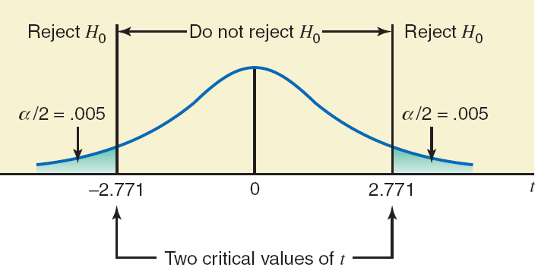
Figure 10.5
Prem Mann, Introductory Statistics, 8/E Copyright © 2013 John Wiley & Sons. All rights reserved.

Slide 60
Example 10-9: Solution
Step 4:
Prem Mann, Introductory Statistics, 8/E Copyright © 2013 John Wiley & Sons. All rights reserved.

Slide 61
Example 10-9: Solution
Step 5:
The test statistic t = -1.560
  It falls in the nonrejection region
Therefore, we fail to reject the null hypothesis
Hence, there is no difference in the mean numbers of
calories per can for the two brands of diet soda.
Prem Mann, Introductory Statistics, 8/E Copyright © 2013 John Wiley & Sons. All rights reserved.

Slide 62

INFERENCES ABOUT THE DIFFERENCE BETWEEN
TWO POPULATION MEANS FOR PAIRED SAMPLES
Interval Estimation of μ_{d}
Hypothesis Testing About μ_{d}
Prem Mann, Introductory Statistics, 8/E Copyright © 2013 John Wiley & Sons. All rights reserved.

Slide 63
INFERENCES ABOUT THE DIFFERENCE BETWEEN TWO POPULATION MEANS FOR PAIRED SAMPLES
Definition
Two samples are said to be paired or matched samples when for each data value collected from one sample there is a corresponding data value collected from the second sample, and both these data values are collected from the same source.
Prem Mann, Introductory Statistics, 8/E Copyright © 2013 John Wiley & Sons. All rights reserved.

Slide 64
INFERENCES ABOUT THE DIFFERENCE BETWEEN TWO POPULATION MEANS FOR PAIRED SAMPLES
Mean and Standard Deviation of the Paired Differences for Two Samples
The values of the mean and standard deviation, and , respectively, of paired differences for two samples are calculated as
Prem Mann, Introductory Statistics, 8/E Copyright © 2013 John Wiley & Sons. All rights reserved.

Slide 65
INFERENCES ABOUT THE DIFFERENCE BETWEEN TWO POPULATION MEANS FOR PAIRED SAMPLES
Sampling Distribution, Mean, and Standard Deviation of d
If is known and either the sample size is large (n ≥ 30) or the population is normally distributed, then the sampling distribution of is approximately normal with its mean and standard deviation given as, respectively
Prem Mann, Introductory Statistics, 8/E Copyright © 2013 John Wiley & Sons. All rights reserved.

Slide 66
INFERENCES ABOUT THE DIFFERENCE BETWEEN TWO POPULATION MEANS FOR PAIRED SAMPLES
Estimate of the Standard Deviation of Paired Differences If
  1. The standard deviation of the population of paired differences is unknown
  2. At least one of the following two conditions is fulfilled:
  i. The sample size is large (i.e., n ≥ 30)
  ii. If the sample size is small, then the population of paired differences is normally distributed… (continued on next slide)
Prem Mann, Introductory Statistics, 8/E Copyright © 2013 John Wiley & Sons. All rights reserved.

Slide 67
INFERENCES ABOUT THE DIFFERENCE BETWEEN TWO POPULATION MEANS FOR PAIRED SAMPLES
Estimate of the Standard Deviation of Paired Differences
then the t distribution is used to make inferences about . The standard deviation of of is estimated by , which is calculated as
Prem Mann, Introductory Statistics, 8/E Copyright © 2013 John Wiley & Sons. All rights reserved.

Slide 68
Interval Estimation of μ_{d}
Confidence Interval for μ_{d}
The (1 – α)100% confidence interval for μ_{d} is
where the value of t is obtained from the t distribution table for the given confidence level and n – 1 degrees of freedom, and is calculated as explained earlier.
Prem Mann, Introductory Statistics, 8/E Copyright © 2013 John Wiley & Sons. All rights reserved.

Slide 69
Example 10-10
A researcher wanted to find the effect of a special diet on systolic blood pressure. She selected a sample of seven adults and put them on this dietary plan for 3 months. The following table gives the systolic blood pressures (in mm Hg) of these seven adults before and after the completion of this plan.
Prem Mann, Introductory Statistics, 8/E Copyright © 2013 John Wiley & Sons. All rights reserved.

Slide 70
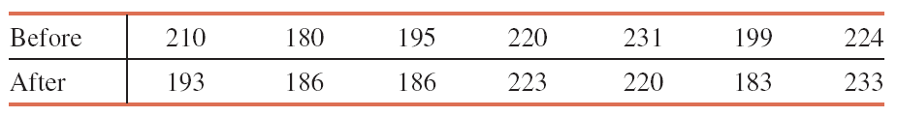
Example 10-10
Let μ_{d} be the mean reduction in the systolic blood pressure due to this special dietary plan for the population of all adults. Construct a 95% confidence interval for μ_{d}. Assume that the population of paired differences is (approximately) normally distributed.
Prem Mann, Introductory Statistics, 8/E Copyright © 2013 John Wiley & Sons. All rights reserved.

Slide 71
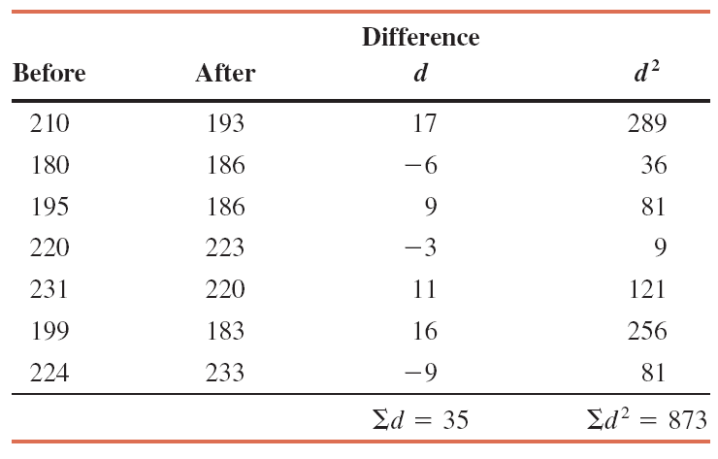
Example 10-10: Solution
Table 10.1
Prem Mann, Introductory Statistics, 8/E Copyright © 2013 John Wiley & Sons. All rights reserved.

Slide 72
Example 10-10: Solution
Prem Mann, Introductory Statistics, 8/E Copyright © 2013 John Wiley & Sons. All rights reserved.

Slide 73
Example 10-10: Solution
Hence,
Prem Mann, Introductory Statistics, 8/E Copyright © 2013 John Wiley & Sons. All rights reserved.

Slide 74
Hypothesis Testing About μ_{d}
Test Statistic t for
The value of the test statistic t for is computed as follows:
Prem Mann, Introductory Statistics, 8/E Copyright © 2013 John Wiley & Sons. All rights reserved.

Slide 75
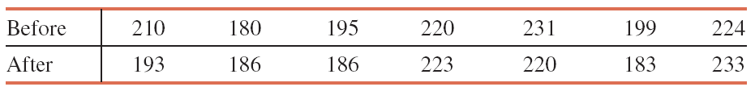
Example 10-12
Refer to Example 10-10. The table that gives the blood pressures (in mm Hg) of seven adults before and after the completion of a special dietary plan is reproduced here.
Prem Mann, Introductory Statistics, 8/E Copyright © 2013 John Wiley & Sons. All rights reserved.

Slide 76
Example 10-12
Let μ_{d} be the mean of the differences between the systolic blood pressures before and after completing this special dietary plan for the population of all adults. Using the 5% significance level, can we conclude that the mean of the paired differences μ_{d} is difference from zero? Assume that the population of paired differences is (approximately) normally distributed.
Prem Mann, Introductory Statistics, 8/E Copyright © 2013 John Wiley & Sons. All rights reserved.

Slide 77
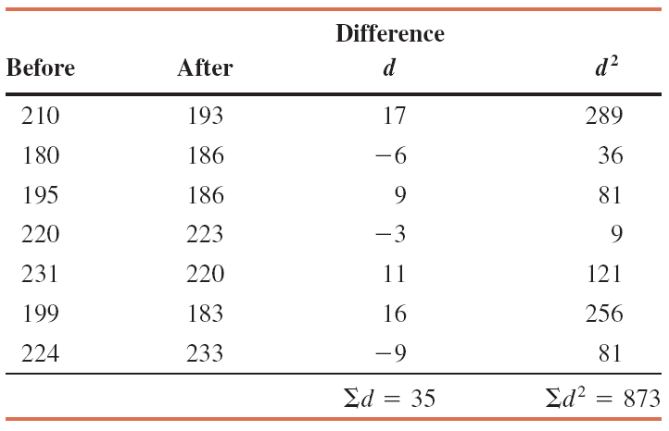
Example 10-12: Solution
Table 10-3
Prem Mann, Introductory Statistics, 8/E Copyright © 2013 John Wiley & Sons. All rights reserved.

Slide 78
Example 10-12: Solution
Prem Mann, Introductory Statistics, 8/E Copyright © 2013 John Wiley & Sons. All rights reserved.

Slide 79
Example 10-12: Solution
Step 1:
H₀: μ_{d} = 0
  (The mean of the paired differences is not different
  from zero)
H₁: μ_{d} ≠ 0
  (The mean of the paired differences is different from
  zero)
Prem Mann, Introductory Statistics, 8/E Copyright © 2013 John Wiley & Sons. All rights reserved.

Slide 80
Example 10-12: Solution
Step 2:
is unknown
The sample size is small
The population of paired differences is (approximately)
normal
We use the t distribution to make the test.
Prem Mann, Introductory Statistics, 8/E Copyright © 2013 John Wiley & Sons. All rights reserved.

Slide 81
Example 10-12: Solution
Step 3:
α = .05
Area in each tail = α / 2 = .05 / 2 = .025
df = n – 1 = 7 – 1 = 6
The two critical values of t are -2.447 and 2.447
Prem Mann, Introductory Statistics, 8/E Copyright © 2013 John Wiley & Sons. All rights reserved.

Slide 82
Example 10-12: Solution
Step 4:
Prem Mann, Introductory Statistics, 8/E Copyright © 2013 John Wiley & Sons. All rights reserved.

Slide 83
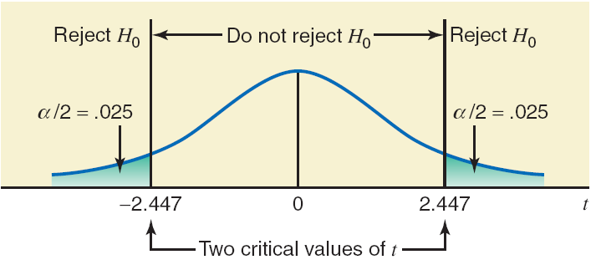
Figure 10.7
Prem Mann, Introductory Statistics, 8/E Copyright © 2013 John Wiley & Sons. All rights reserved.

Slide 84
Example 10-12: Solution
Step 5:
The value of the test statistic t = 1.226
It falls in the nonrejection region
Therefore, we fail to reject the null hypothesis
Hence, we conclude that the mean of the population paired
differences is not different from zero.
Prem Mann, Introductory Statistics, 8/E Copyright © 2013 John Wiley & Sons. All rights reserved.

Slide 85

INFERENCES ABOUT THE DIFFERENCE BETWEEN TWO POPULATION PROPORTIONS FOR LARGE AND INDEPENDENT SAMPLES
Mean, Standard Deviation, and Sampling Distribution
of
Interval Estimation of
Hypothesis Testing About
Prem Mann, Introductory Statistics, 8/E Copyright © 2013 John Wiley & Sons. All rights reserved.

Slide 86
Mean, Standard Deviation, and Sampling Distribution of
For two large and independent samples, the sampling
distribution of is (approximately) normal with its
mean and standard deviation given as
and
respectively, where q₁ = 1 – p₁ and q₂ = 1 – p₂.
Prem Mann, Introductory Statistics, 8/E Copyright © 2013 John Wiley & Sons. All rights reserved.

Slide 87
Interval Estimation of p₁ – p₂
The (1 – α)100% confidence interval for p₁ – p₂ is
where the value of z is read from the normal distribution table for the given confidence level, and is calculated as
Prem Mann, Introductory Statistics, 8/E Copyright © 2013 John Wiley & Sons. All rights reserved.

Slide 88
Example 10-13
A researcher wanted to estimate the difference between the percentages of users of two toothpastes who will never switch to another toothpaste. In a sample of 500 users of Toothpaste A taken by this researcher, 100 said that they will never switch to another toothpaste. In another sample of 400 users of Toothpaste B taken by the same researcher, 68 said that they will never switch to another toothpaste.
Prem Mann, Introductory Statistics, 8/E Copyright © 2013 John Wiley & Sons. All rights reserved.

Slide 89
Example 10-13
(a) Let p₁ and p₂ be the proportions of all users of Toothpastes A and B, respectively, who will never switch to another toothpaste. What is the point estimate of p₁ – p₂?
(b) Construct a 97% confidence interval for the difference between the proportions of all users of the two toothpastes who will never switch.
Prem Mann, Introductory Statistics, 8/E Copyright © 2013 John Wiley & Sons. All rights reserved.

Slide 90
Example 10-13: Solution
The two sample proportions are calculated as follows:
Then,
Prem Mann, Introductory Statistics, 8/E Copyright © 2013 John Wiley & Sons. All rights reserved.

Slide 91
Example 10-13: Solution
(a) Point estimate of p₁ – p₂
=
= .20 – .17 = .03
Prem Mann, Introductory Statistics, 8/E Copyright © 2013 John Wiley & Sons. All rights reserved.

Slide 92
Example 10-13: Solution
(b)
Prem Mann, Introductory Statistics, 8/E Copyright © 2013 John Wiley & Sons. All rights reserved.

Slide 93
Example 10-13: Solution
(b)
Each of these values is greater than 5.
Both sample sizes are large.
Consequently, we use the normal distribution to make a confidence interval for p₁ – p₂.
Prem Mann, Introductory Statistics, 8/E Copyright © 2013 John Wiley & Sons. All rights reserved.

Slide 94
Example 10-13: Solution
(b) The standard deviation of is
With z = 2.17,
Prem Mann, Introductory Statistics, 8/E Copyright © 2013 John Wiley & Sons. All rights reserved.

Slide 95
Hypothesis Testing About p₁ – p₂
Test Statistic z for
The value of the test statistic z for is calculated as
The value of p₁ – p₂ is substituted from H₀, which is usually zero.
Prem Mann, Introductory Statistics, 8/E Copyright © 2013 John Wiley & Sons. All rights reserved.

Slide 96
Hypothesis Testing About p₁ – p₂
Prem Mann, Introductory Statistics, 8/E Copyright © 2013 John Wiley & Sons. All rights reserved.

Slide 97
Example 10-14
Reconsider Example 10-13 about the percentages of users of two toothpastes who will never switch to another toothpaste. At the 1% significance level, can we conclude that the proportion of users of Toothpaste A who will never switch to another toothpaste is higher than the proportion of users of Toothpaste B who will never switch to another toothpaste?
Prem Mann, Introductory Statistics, 8/E Copyright © 2013 John Wiley & Sons. All rights reserved.

Slide 98
Example 10-14: Solution
Prem Mann, Introductory Statistics, 8/E Copyright © 2013 John Wiley & Sons. All rights reserved.

Slide 99
Example 10-14: Solution
Step 1:
H₀: p₁ – p₂ = 0
  (p₁ is not greater than p₂₎
H₁: p₁ – p₂ > 0
  (p₁ is greater than p₂₎
Prem Mann, Introductory Statistics, 8/E Copyright © 2013 John Wiley & Sons. All rights reserved.

Slide 100
Example 10-14: Solution
Step 2:
, , , and are all greater than 5
Both samples sizes are large
We use the normal distribution to make the test
Prem Mann, Introductory Statistics, 8/E Copyright © 2013 John Wiley & Sons. All rights reserved.

Slide 101
Example 10-14: Solution
Step 3:
The > sign in the alternative hypothesis indicates that the
test is right-tailed.
α = .01
The critical value of z is 2.33
Prem Mann, Introductory Statistics, 8/E Copyright © 2013 John Wiley & Sons. All rights reserved.

Slide 102
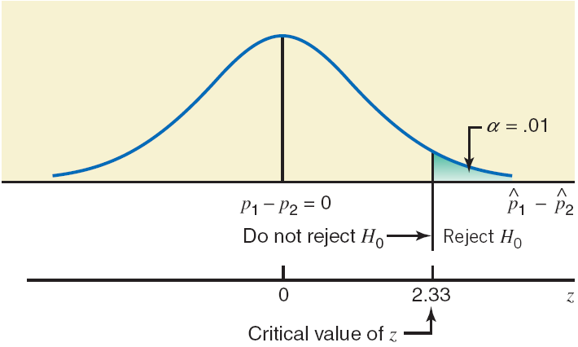
Figure 10.8
Prem Mann, Introductory Statistics, 8/E Copyright © 2013 John Wiley & Sons. All rights reserved.

Slide 103
Example 10-14: Solution
Step 4:
Prem Mann, Introductory Statistics, 8/E Copyright © 2013 John Wiley & Sons. All rights reserved.

Slide 104
Example 10-14: Solution
Step 5:
The value of the test statistic z = 1.15
  It falls in the nonrejection region
We fail to reject the null hypothesis
Therefore, we conclude that the proportion of users of
Toothpaste A who will never switch to another toothpaste
is not greater that the proportion of users of Toothpaste B
who will never switch to another toothpaste.
Prem Mann, Introductory Statistics, 8/E Copyright © 2013 John Wiley & Sons. All rights reserved.

Slide 105

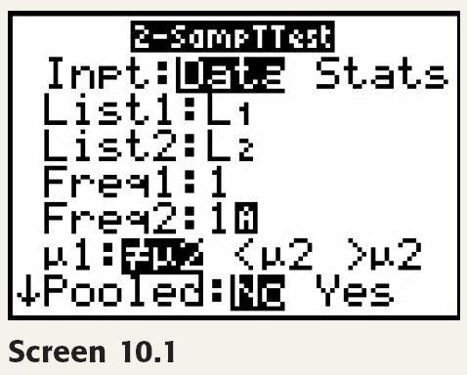
TI-84
Prem Mann, Introductory Statistics, 8/E Copyright © 2013 John Wiley & Sons. All rights reserved.

Slide 106
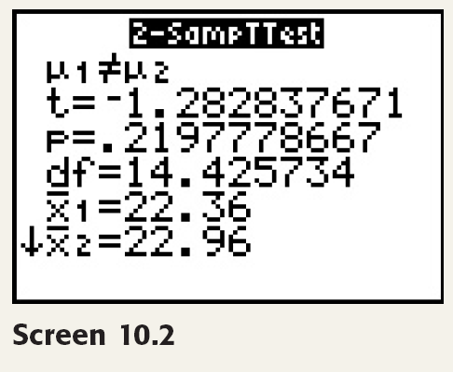
TI-84
Prem Mann, Introductory Statistics, 8/E Copyright © 2013 John Wiley & Sons. All rights reserved.

